Slide 1
Signal-Plus-Noise Models vs. Stationary Models

Slide 2
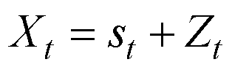
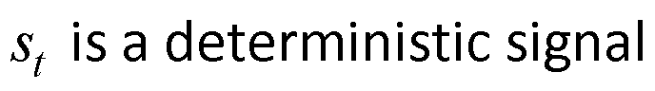
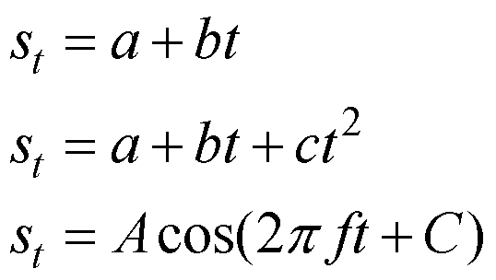
Deterministic Signal-Plus-Noise Models
Example signals:
C constant
X_{t} is non-stationary because of
non-constant mean.

Slide 3
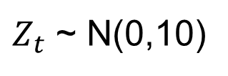
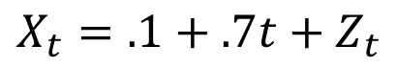
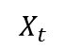
Deterministic Signal-Plus-Noise Models
Example signal:
$$X_{t}=.1+.7t+Z_{t}$$
$Z_{t}$ ~ N(0,10)
Realization
Signal
Noise
$$X_{t}$$
X_{t} is non-stationary because of non-constant mean.
Xs = gen.sigplusnoise.wge(100,.1,.7,vara = 10,sn = 9)
Xtrend = .1+.7*seq(1,100,length = 100)
resids = Xs - Xtrend
plot(resids, type = "l")

Slide 4
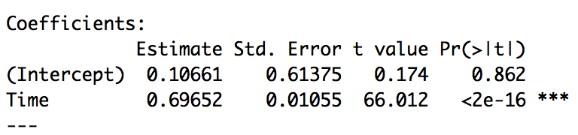
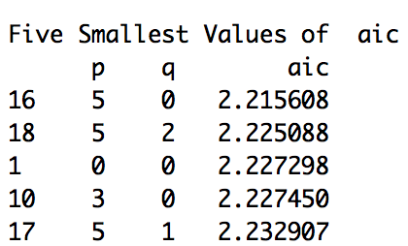
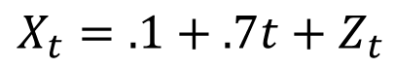
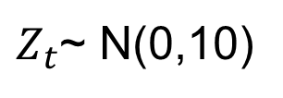
Deterministic Signal-Plus-Noise Models
Example signal:
$$X_{t}=.1+.7t+Z_{t}$$
$Z_{t}$~ N(0,10)
In practice, we only have the realization and we don’t know that beta_0 = .1 and beta_1 = .7. In practice, we will estimate fit a line and estimate them.
Realization
Estimated signal
Residuals (noise)
Xs = gen.sigplusnoise.wge(100,.1,.7,vara = 10,sn = 9)
Xtrend = .1+.7*seq(1,100,length = 100)
resids = Xs - Xtrend
plot(resids, type = "l")
df = data.frame(Time = seq(1,100,length = 100),Xs = Xs)
fit = lm(Xs~Time, data = df)
summary(fit)
plot(df$Time,df$Xs,type = "l")
lines(fit$fitted.values, col = "red")
plot(fit$residuals)

Slide 5
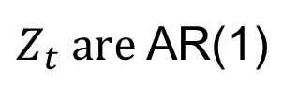
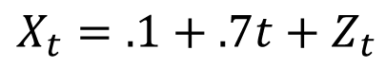
Deterministic Signal-Plus-Noise Models
Example signals:
$$X_{t}=.1+.7t+Z_{t}$$
$Z_{t} are$AR(1)
Realization
Signal
Noise
X_{t} is non-stationary because of non-constant mean.
Signal = gen.sigplusnoise.wge(100,.1,.7,vara = 0, sn = 7)
Noise = gen.arma.wge(100,phi = .9,vara = 10, sn = 7)
Xs = Signal + Noise
plot(Xs, type = "l")
Xhats = .1+.7*seq(1,100,length = 100)
resids = Xs - Xhats
plot(resids, type = "l")

Slide 6
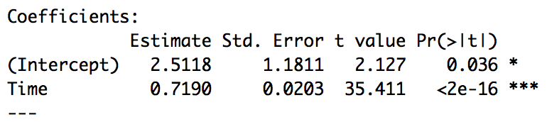
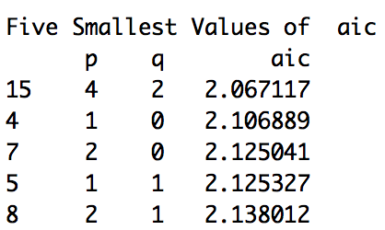
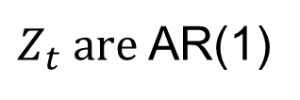
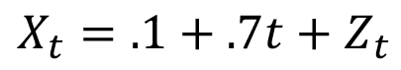
Deterministic Signal-Plus-Noise Models
Example signals:
$$X_{t}=.1+.7t+Z_{t}$$
$Z_{t} are$AR(1)
In practice, we only have the realization and we don’t know that beta_0 = .1 and beta_1 = .7. In practice, we will estimate fit a line and estimate them.
Realization
Estimated signal
Residuals (noise)
We know that the noise is AR(1), and that is one of the models suggested by the AIC. We will wait to show how to identify the model and estimate the coefficients in future Units.
Signal = gen.sigplusnoise.wge(100,.1,.7,vara = 0, sn = 7)
Noise = gen.arma.wge(100,phi = .9,vara = 10, sn = 7)
Xs = Signal + Noise
plot(Xs, type = "l")
df = data.frame(Time = seq(1,100,length = 100),Xs = Xs)
fit = lm(Xs~Time, data = df)
summary(fit)
plot(df$Time,df$Xs,type = "l")
lines(fit$fitted.values, col = "red")
plot(fit$residuals, type = “l”)
aic5.wge(fit$residuals)

Slide 7
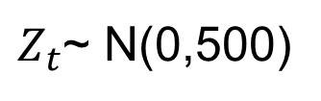
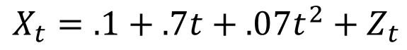
Deterministic Signal-Plus-Noise Models
Example signals:
$$X_{t}=.1+.7t+.07t^{2}{+ Z}_{t}$$
$Z_{t}$~ N(0,500)
Realization
Signal
Noise
X_{t} is nonstationary because of non-constant mean.
We will need to add the squared term manually in tswge
Signal_lin = gen.sigplusnoise.wge(100,.1,.7,vara = 500, sn = 9)
Signal_quad = .07*seq(1,100)^2
Xs = Signal_lin + Signal_quad
plot(Xs, type = "l")
Xhats = .1 + .7*seq(1,100) + .07 * seq(1,100)^2
resids = Xs - Xhats
plot(resids,type = "l")

Slide 8
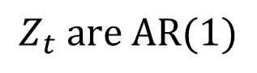
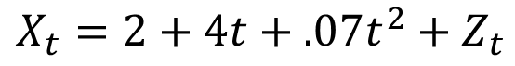
Deterministic Signal-Plus-Noise Models
Example signals:
$$X_{t}=2+4t+.07t^{2}{+ Z}_{t}$$
$$Z_{t} are AR(1)$$
Realization
Signal
Noise
X_{t} is nonstationary because of non-constant mean.
Signal_lin = gen.sigplusnoise.wge(100,.1,.7,vara = 0, sn = 9)
Signal_quad = .07*seq(1,100)^2
Noise = gen.arma.wge(100,phi = .95,vara = 500, sn = 9)
Xs = Signal_lin + Signal_quad + Noise
plot(Xs, type = "l")
Xhats = .1 + .7*seq(1,100) + .07 * seq(1,100)^2
resids = Xs - Xhats
plot(resids,type = "l")

Slide 9
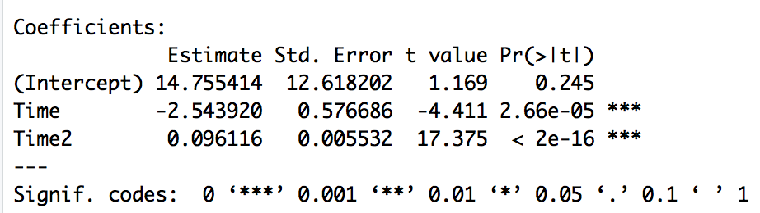
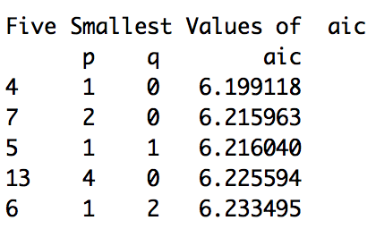
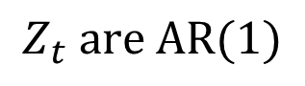
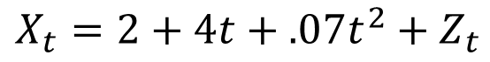
Deterministic Signal-Plus-Noise Models
Example signals:
$$X_{t}=2+4t+.07t^{2}{+ Z}_{t}$$
$$Z_{t} are AR(1)$$
In practice, we only have the realization and we don’t know that beta_0 = 2 and beta_1 = 4 and beta_2 = .07. In practice, we will estimate fit a model and estimate them.
Realization
Estimated signal
Residuals (noise)
We know that the noise is AR(1), and that is one of the models suggested by the AIC. We will wait to show how to identify the model and estimate the coefficients in future Units.
Signal_lin = gen.sigplusnoise.wge(100,.1,.7,vara = 0, sn = 9)
Signal_quad = .07*seq(1,100)^2
Noise = gen.arma.wge(100,phi = .95,vara = 500, sn = 9)
Xs = Signal_lin + Signal_quad + Noise
plot(Xs, type = "l")
Time = seq(1,100,length = 100)
df = data.frame(Time = Time,Xs = Xs, Time2 = Time^2)
fit = lm(Xs~Time + Time2, data = df)
summary(fit)
plot(df$Time,df$Xs,type = "l")
lines(fit$fitted.values, col = "red")
plot(fit$residuals, type = "l")
aic5.wge(fit$residuals)

Slide 10
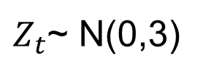
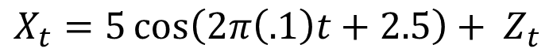
Deterministic Signal-Plus-Noise Models
Example signals:
C constant
$$X_{t}=5\cos\left(2π\left(.1\right)t+2.5\right)+ Z_{t}$$
$Z_{t}$~ N(0,3)
Realization
Signal
Noise
X_{t} is nonstationary because of non-constant mean.
Xs = gen.sigplusnoise.wge(100,coef=c(5,0),freq = c(.1,0), phi = 0, psi = c(2.5,0),vara = 3, sn =9)
Xhats= gen.sigplusnoise.wge(100,coef=c(5,0),freq = c(.1,0), phi = 0, psi = c(2.5,0),vara = 0, sn =9)
resids = Xs - Xhats
plot(resids,type = "l")
Notes:
Add slides with AR(1) Errors … maybe a couple per example (weak and strong) and show residuals.

Slide 11
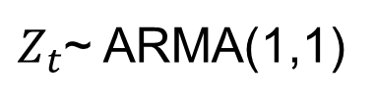
Deterministic Signal-Plus-Noise Models
Example signals:
C constant
$$X_{t}=5\cos\left(2π\left(.1\right)t+2.5\right)+ Z_{t}$$
$Z_{t}$~ ARMA(1,1)
Realization
Signal
Noise
X_{t} is nonstationary because of non-constant mean.
Signal = gen.sigplusnoise.wge(100,coef=c(5,0),freq = c(.1,0), phi = 0, psi = c(2.5,0),vara = 0, sn =9)
Noise = gen.arma.wge(100,phi = .97, theta = -.99, vara = 10, sn = 9)
Xs = Signal + Noise
Xhats= gen.sigplusnoise.wge(100,coef=c(5,0),freq = c(.1,0), phi = 0, psi = c(2.5,0),vara = 0, sn =9)
resids = Xs - Xhats
plot(resids,type = "l")
Notes:
Add slides with AR(1) Errors … maybe a couple per example (weak and strong) and show residuals.

Slide 12
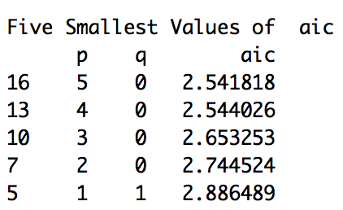
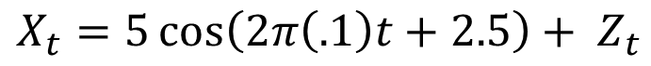
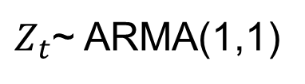
Deterministic Signal-Plus-Noise Models
Example signals:
C constant
$$X_{t}=5\cos\left(2π\left(.1\right)t+2.5\right)+ Z_{t}$$
$Z_{t}$~ ARMA(1,1)
Realization
Signal
Noise
We know that the noise is AR(1,1), and that is one of the models suggested by the AIC. We will wait to show how to identify the model and estimate the coefficients in future Units.
Signal = gen.sigplusnoise.wge(100,coef=c(5,0),freq = c(.1,0), phi = 0, psi = c(2.5,0),vara = 0, sn =9)
Noise = gen.arma.wge(100,phi = .97, theta = -.99, vara = 10, sn = 9)
Xs = Signal + Noise
Xhats= gen.sigplusnoise.wge(100,coef=c(5,0),freq = c(.1,0), phi = 0, psi = c(2.5,0),vara = 0, sn =9)
resids = Xs - Xhats
plot(resids,type = "l")
Notes:
Add slides with AR(1) Errors … maybe a couple per example (weak and strong) and show residuals.

Slide 14
Signal Present?

Slide 15
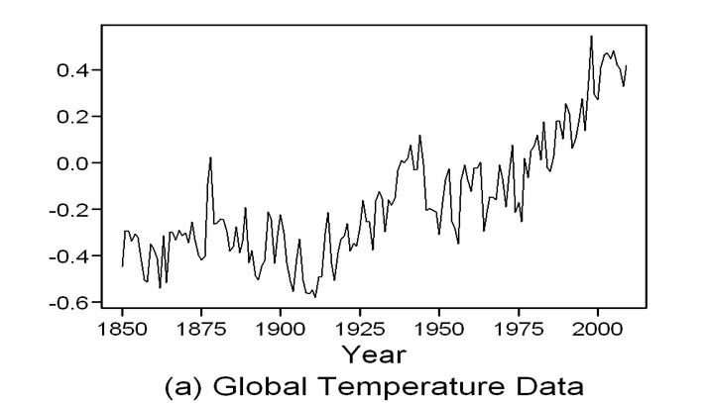
Sometimes it’s not easy to tell whether a deterministic signal is present in the data
Is there a deterministic signal?

Slide 16
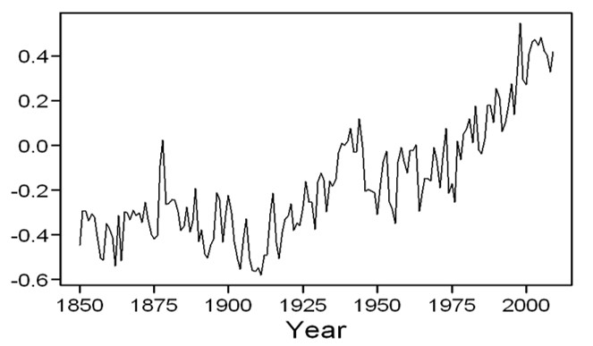
Realizations
Sometimes it’s not easy to tell whether a deterministic signal is present in the data
We know these were generated from a stationary (AR(4)) model!
Global warming?
parms = mult.wge(c(.975),c(.2,-.45),c(-.53))
gen.arma.wge(160,phi = parms$model.coef,vara = 1, sn = 23)
parms = mult.wge(c(.975),c(.2,-.45),c(-.53))
gen.arma.wge(160,phi = parms$model.coef,vara = 1, sn = 13)

Slide 17
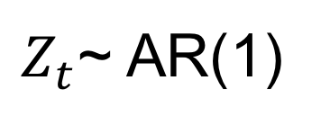
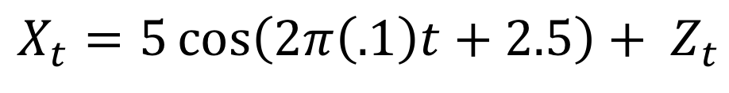
$$X_{t}=5\cos\left(2π\left(.1\right)t+2.5\right)+ Z_{t}$$
$Z_{t}$~ AR(1)

Slide 18
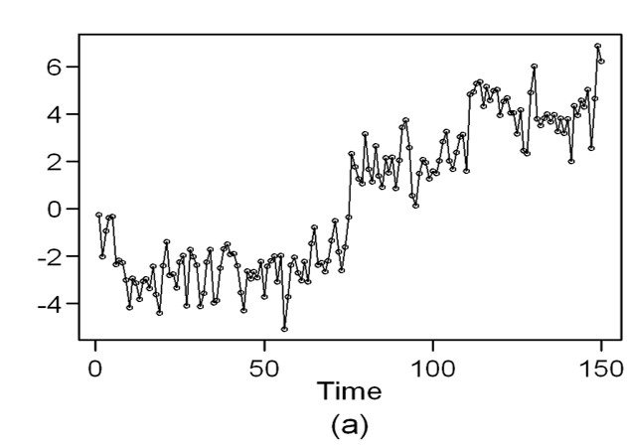
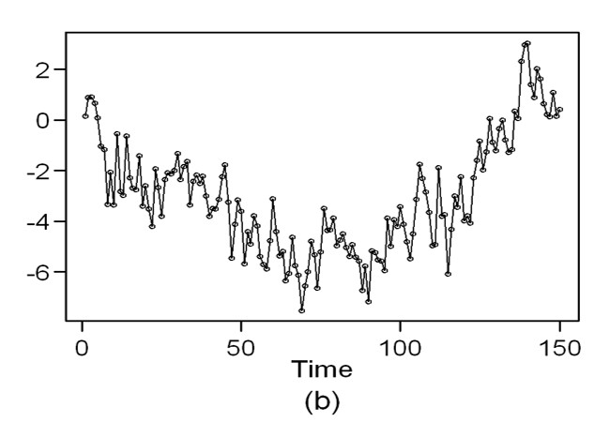
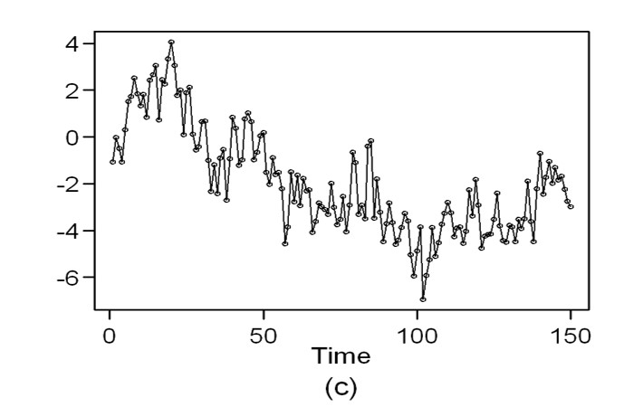
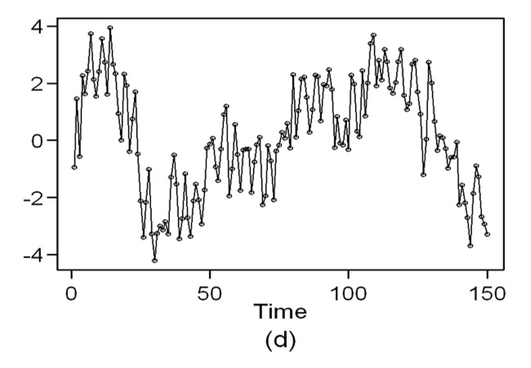
Four Realizations from the Stationary AR(4) Model
$$\text{(1−.645}\text{B}\text{ +.02225}\text{B}\text{2}\text{ − .0969}\text{B}\text{3}\text{ −.2325}\text{B}\text{4}\text{)}\text{Xt}\text{ = }\text{at}$$

Slide 20
Screencast for Signal-Plus-Noise Models

Slide 21
Screencast: Just run these a few times to show that sometimes you just randomly get something that looks like it has trend, even when it does not.
gen.sigplusnoise.wge(100,2,4,vara = 100)
gen.sigplusnoise.wge(100,0,0,vara = 10)
parms = mult.wge(c(.975),c(.2,-.45),c(-.53))
gen.arma.wge(160,phi = parms$model.coef,vara = 1)
Notes:
Be sure and demonstrate How to generate an AR(4) or AR(3) … you can show the model / polynomial on a Powerpoint slide on the screen and the R Studio / coding on the other half of the screen.

Slide 22
Also, be able to generate realizations from a model in factored form
parms = mult.wge(c(.975),c(.2,-.45),c(-.53))
parms$model.coef
# Output:
# [1] 0.6450000 -0.0222500 0.0969000 0.2325375
#Now that we have the coefficients, () we can generate a realization.
gen.arma.wge(160,phi = parms$model.coef,vara = 1)
Notes:
Be sure and demonstrate How to generate an AR(4) or AR(3) … you can show the model / polynomial on a Powerpoint slide on the screen and the R Studio / coding on the other half of the screen.

Slide 24
ARIMA Properties and Characteristics

Slide 25
ARIMA(p,d,q) Models
The autoregressive integrated moving average process of orders p, d, and q (denoted ARIMA(p,d,q)) is a process, X_{t} , whose differences (1− B)^{d} X_{t} satisfy a (stationary) ARMA(p,q) model, where d is a non-negative integer.
We use the notation:
d = 1
$$\left(1 − .67B\right)(1−1.6B+.8B^{2})\left(1−B\right)X_{t}=(1−.84B)a_{t}$$
ARIMA(3,1,1)
You can generate realizations from the ARIMA(p,d,q) model using gen.arima.wge

Slide 26
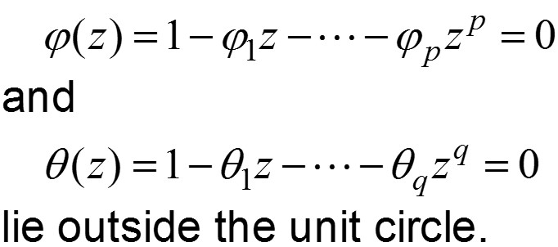
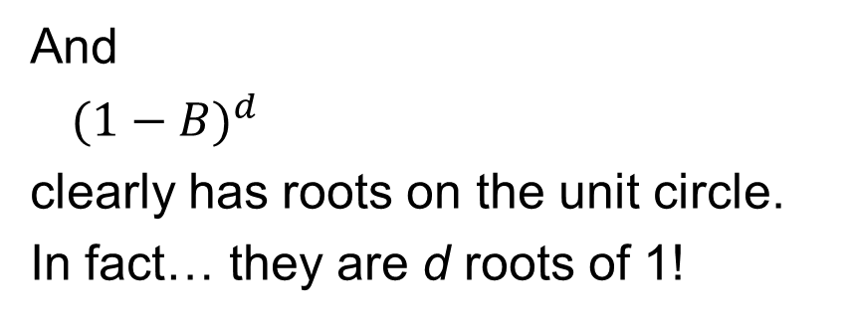
ARIMA(p,d,q) Models
And
${(1−B)}^{d}$
clearly has roots on the unit circle.
In fact… they are d roots of 1!
The non-stationary part!

Slide 28
Extended Autocorrelations

Slide 29
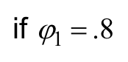
Question: What is ρ _{k} for an ARIMA(p,d,q) process?
Light board?

Slide 30
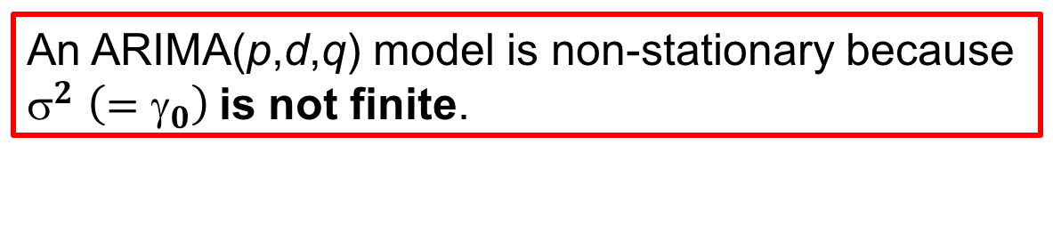
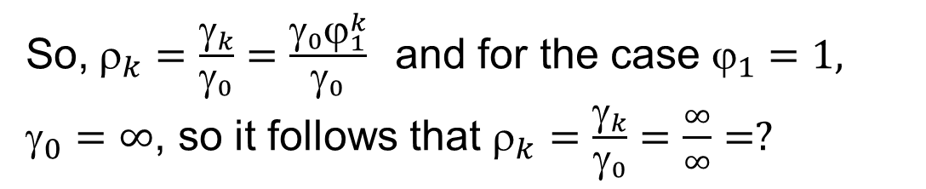
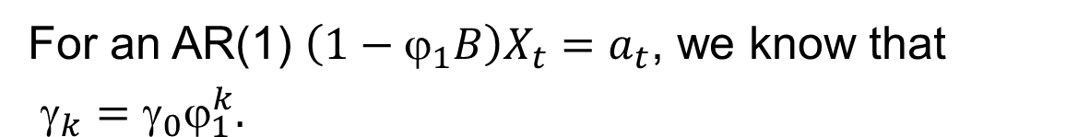
An ARIMA(p,d,q) model is non-stationary because $^{2}$ $\left(=γ_{0}\right)$is not finite.
For an AR(1) $\left(1−ϕ_{1}B\right)X_{t}=a_{t}$, we know that
$_{k}=_{0}_{1}^{k}.$
So,$_{k}=\frac{γ_{k}}{γ_{0}}=\frac{γ_{0}ϕ_{1}^{k}}{γ_{0}}$and for the case $_{1}=1,$ $_{0}=∞$, so it follows that $_{k}=\frac{γ_{k}}{γ_{0}}=\frac{∞}{∞}=?$
Light board ?

Slide 31
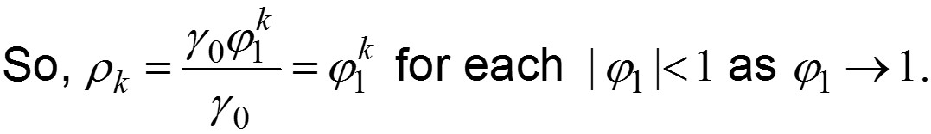
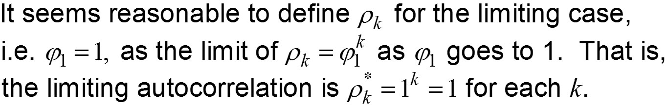
Clearly, we need a new definition of autocorrelation for the case (1−B) X_{t} = a_{t}.
Light board?
“Woodward and colleagues use the term “extended autocorrelations.” We will continue to call them “autocorrelations” for simplicity.
Notes:
When do we use / plot the extended autocorrelations?

Slide 33
ARIMA and tswge

Slide 34
x1=gen.arima.wge(n=200, d=1)
plotts.sample.wge(x1)
x2=gen.arima.wge(n=200, phi=c(1.5,-.8),d=1)
plotts.sample.wge(x2)
x3=gen.arima.wge(n=200, phi=c(1.5,-.8),d=2,theta=-.8)
plotts.sample.wge(x3)

Slide 36
ARIMA
Examples

Slide 37
ARIMA(0,1,0)
Notes:
The value of X_{t} at time t is equal to the value at time t − 1 plus a random, zero-mean noise component.
At each time, t, the process is equally likely to go up or down from time t − 1.
This is wandering (random walk) behavior.
Notes:
Do we need the first line? Y?

Slide 38
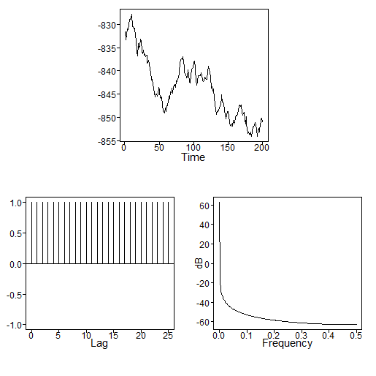
ARIMA(0,1,0)
#R Code:
x = gen.arima.wge(200,phi = 0, var = 1,d = 1,sn = 31)
acf(x)
Realization
True autocorrelations
Sample autocorrelations
Strictly wandering since there is one factor with a root of 1
Identically equal to ρ_{k} = 1
Slowly damping, even though true values don’t damp

Slide 40
Differencing Data

Slide 41
“Difference” the data using tswge.
tswge transformation function…. run this code!
# the following command differences the data in x
y=artrans.wge(x,phi.tr=1)
# This simply means that y(i) = x(i) – x(i-1)
# y has length n-1 because x(1) has no x(0) before it.
# Example
x = c(1,3,6,10,25)
y = artrans.wge(x,phi.tr = 1)
y # shows the 4 differences

Slide 43
ARIMA
Examples

Slide 44
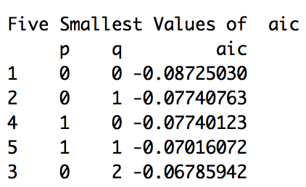
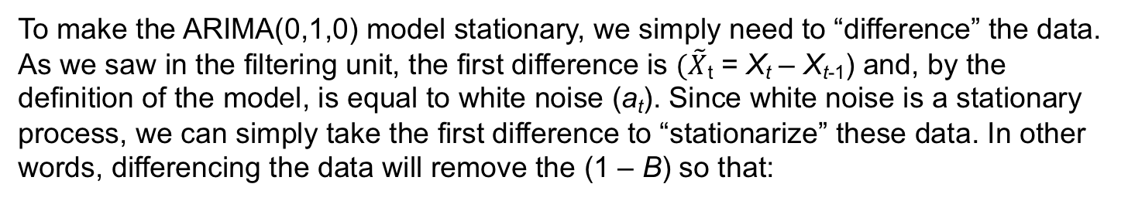
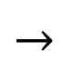


Stationarize the ARIMA(0,1,0): Taking out the (1 – B)
$$→$$
$$X_{t}−X_{t−1}=a_{t}$$
Realization
Sample autocorrelations
#R Code:
x = gen.arima.wge(200,phi = 0, var = 1,d = 1,sn = 31)
acf(x)
To make the ARIMA(0,1,0) model stationary, we simply need to “difference” the data. As we saw in the filtering unit, the first difference is $(\tilde{X}$_{t} = X_{t} – X_{t-1}) and, by the definition of the model, is equal to white noise (a_{t}). Since white noise is a stationary process, we can simply take the first difference to “stationarize” these data. In other words, differencing the data will remove the (1 – B) so that:
$${\tilde{X}}_{t}=a_{t}$$
Realization
Sample autocorrelations
#R Code:
Xtilde = artrans.wge(x,1)
plotts.wge(Xtilde)
acf(Xtilde)
Notes:
Derive at from Xtilde

Slide 45
Stationarize the ARIMA(0,1,0): Taking out the (1 – B)
x = gen.arima.wge(200,phi = 0, var = 1,d = 1,sn = 31)
artrans.wge(x,1)
aic5.wge(artans.wge(x,1))
*
* We will estimate the coefficients of these models in a later unit.

Slide 46

ARIMA(0,1,0): Stock Example
Amazon Stock
Plot care of yahoo finance.
Notes:
Add code… how to plot true autocorrelations of ARIMA models?

Slide 47

ARIMA(0,1,0): Stock Example
Amazon stock
*
amzn = read.csv(file.choose(),header = TRUE)
x = artrans.wge(amzn$Adj.Close,1)
* We will estimate the coefficients of these models in a later unit.
Notes:
Add code… how to plot true autocorrelations of ARIMA models?

Slide 48
ARIMA(2,1,0)
(1 − 1.5B + .8B²)(1 − B)X_{t} = a_{t}
Realization
True autocorrelations
Sample autocorrelations
Wandering with possibly a hint of the cyclic behavior
Identically equal to ρ_{k} = 1 (even though there is second order cyclic stationary factor)
Slowly damping with very little indication of cyclic behavior
Notes:
Add code… how to plot true autocorrelations of ARIMA models?

Slide 49

ARIMA(2,1,0)
(1 − 1.5B + .8B²)(1 − B)X_{t} = a_{t}
Realization
Sample autocorrelations
Sample Spectral Density
Wandering with possibly a hint of the cyclic behavior
Slowly damping with very little indication of cyclic behavior
There is a slight peak at .09, but the dominating behavior is at 0
Notes:
Add code… how to plot true autocorrelations of ARIMA models?

Slide 50

Stationarize the ARIMA(2,1,0): Taking out the (1–B)
(1 − 1.5B + .8B²)(1 − B)X_{t} = a_{t}
x = gen.arima.wge(200,phi = c(1.5,-.8), var = 1,d = 1,sn = 31)
FirstDif = artrans.wge(x,1) #Take out the (1-B)
parzen.wge(FirstDif)
aic5.wge(FirstDif) #Check the structure of the noise
*
* We will estimate the coefficients of these models in a later unit.

Slide 51

ARIMA(2,1,0)
(1 − 1.5B + .8B²)(1 − B)X_{t} = a_{t}
Realization
True autocorrelations
Sample autocorrelations
Wandering with possibly a hint of the cyclic behavior
Identically equal to ρ_{k} = 1 (even though there is second order cyclic stationary factor)
Slowly damping with very little indication of cyclic behavior
Notes:
Add code… how to plot true autocorrelations of ARIMA models?

Slide 52


ARIMA(2,2,1)
(1 − 1.5B + .8B²)(1 − B)² X_{t} = (1 + .8B)a_{τ}
Realization
True autocorrelations
Sample autocorrelations
Very highly correlated wandering behavior with no hint of the cyclic factor (dominated by the two roots of 1)
Again, identically equal to ρ_{k} = 1
Very slowly damping with no indication of cyclic or MA behavior… mostly because of the way they are calculated
Notes:
Add code… how to plot true autocorrelations of ARIMA models?

Slide 53
ARIMA(2,2,1)
(1 − 1.5B + .8B²)(1 − B)² X_{t} = (1 + .8B)a_{τ}
Realization
Sample autocorrelations
Sample spectral density
Very highly correlated wandering behavior with no hint of the cyclic factor (dominated by the two roots of 1)
Very slowly damping with no indication of cyclic or MA behavior
There is almost no evidence of the frequency at .0917
Notes:
Add code… how to plot true autocorrelations of ARIMA models?

Slide 54


Stationarize the ARIMA(2,2,1): Taking out the (1 – B)²
(1 − 1.5B + .8B²)(1 − B)² X_{t} = (1 + .8B)a_{τ}
x = gen.arima.wge(200,phi = c(1.5,-.8), var = 1,d = 2,sn = 31)
FirstDif = artrans.wge(x,1) #Take out the (1-B)
SecondDif = artrans.wge(FirstDif,1) # Take out the other (1-B)
parzen.wge(SecondDif)
aic5.wge(SecondDif) #Check the structure of the noise
*
* We will estimate the coefficients of these models in a later unit.

Slide 56
ARIMA
General Comments

Slide 57
General Comments about ARIMA Models
The (1 − B)^{d} factor dominates the stationary components.
In the realizations
Autocorrelations
Spectral densities all have peaks at f = 0
For d > 1, this domination is even more striking.
The true autocorrelations are equal to 1 for all k.
The sample autocorrelations will always damp (in part because of the way they are calculated).
Slowly damping sample autocorrelations is an indication of ARIMA data.

Slide 59
Seasonal Models | Properties and Characteristics

Slide 60


Seasonal Models
Contain factor (1 − Β ^{s})
Monthly data (1 − Β ¹²), quarterly data (1 − Β ⁴),…
=1
=1
Example seasonal models

Slide 62
Seasonal Models | Examples

Slide 63

i.e.
Etc.
For quarterly sales data, this model says that sales in the current quarter are equal to the sales for this quarter last year plus a random-noise term.

Slide 64
Light board
First:
(simple factoring)
Notes:
Keep as slide? Maybe add a Lightboard as well?

Slide 65


Notes about the models:
“Quarterly” behavior is present in realization (but not as clear as it was in the initial realization of length n = 20).
Sample autocorrelations at lags 4, 8,… are “large,” which is consistent with the model.
That is, X_{t}, X_{t+4}, X_{t+8},… would be expected to be “similar.”
The spectral estimate has peaks at f = 0, .25, and .5 (we’ll come back to this).
$$\left(1−B^{4}\right)=(1−B)(1+B^{2})(1+B)$$

Slide 66

Notes about the models:
“Quarterly” behavior is still present in realization.
Sample autocorrelations at lags 4, 8,… are “large.”
The spectral estimate has peaks at f = 0, .25, and .5).

Slide 67

Notes about the models:
“Monthly” (seasonal behavior at lag 12) behavior is present in realization.
Sample autocorrelations at lags 12, 24,… are “large.”
The spectral estimate has mild peaks at f = 0 and .5 along with 5 fairly equally spaced peaks between 0 and .5) (we’ll come back to this shortly).

Slide 68
Notes
Before proceeding, we note that Woodward, Gray, and Elliott (2017) also define an ARUMA model as a generalization of the ARIMA model.
Although we will not discuss these in detail, we do mention that seasonal models (which will be discussed shortly) are special cases of ARUMA models.
We will use the tswge function gen.aruma.wge to generate realizations from seasonal models.

Slide 70
Seasonal Models, ARUMA and tswge

Slide 71
tswge demo
Below, we use the tswge commands.
gen.aruma.wge (to generate realizations from seasonal models)
plotts.sample.wge to plot the realizations, sample autocorrelations, and spectral estimates.
We recommend running these commands several times to get a better idea of the typical behavior
x1=gen.aruma.wge(n=80, s=4, sn = 5)
plotts.sample.wge(x1)
x2=gen.aruma.wge(n=80, phi=c(1,-.6),s=4,theta=-.5)
plotts.sample.wge(x2)
x3=gen.aruma.wge(n=180, phi=c(1,-.6),s=12,theta=-.5)
plotts.sample.wge(x3,lag.max=48)

Slide 73
Stationarize an ARUMA

Slide 74

Stationarize Quarterly Data: Taking out the (1 – B⁴)
x=gen.aruma.wge(n=80, s=4, sn = 81) #tswge function to generate ARIMA and Seasonal Models
Dif = artrans.wge(x,c(0,0,0,1)) #Take out the (1-B^4)
aic5.wge(Dif) #Check the structure of the noise
*
* We will estimate the coefficients of these models in a later unit.

Slide 75

Stationarize Monthly Seasonal Data: Taking out the (1 – B¹²)
(1 – .4B − .6B² + .74B³)(1 − B¹²) X_{t} = (1 + .7B)a_{t}
x=gen.aruma.wge(n=80, phi = c(.4,.6,-.74), theta = c(-.7), s=12, sn = 31)
Dif = artrans.wge(x,c(rep(0,11),1)) #Take out the (1-B^12)
aic5.wge(Dif) #Check the structure of the noise
*
* We will estimate the coefficients of these models in a later unit.

Slide 77
Seasonal Models | Factor Tables

Slide 78
Previously, we noted that, using simple factoring, we obtain
Recall, we can factor a polynomial using the tswge function factor.wge. In this case, the command is
factor.wge(phi=c(0,0,0,1)) or factor.wge(phi=c(rep(0,3),1)).
To factor 1−z¹², we use
factor.wge(phi=c(0,0,0,0,0,0,0,0,0,0,0,1)) or factor.wge(phi=c(rep(0,11),1)).

Slide 79




Factor Tables
Factor | Roots | Abs Recip | f
1 − B | 1 | 1 | 0
1 + B² | ±i | 1 | .25
1 + B | 1 | 1 | .5
Factor | Root(s) | Abs Recip | f
1 – B | 1 | 1 | 0
 | .866 + .5i | 1 | .083
1 − B + B² | .5 + .866i | 1 | .167
1 + B² | +i | 1 | .25
1 + B + B² | −.5 + .866i | 1 | .333
 | −.866 + .5i | 1 | .417
1 + B | −1 | 1 | .5
Notes:
we will return to these Factor Tables when we fit seasonal models to data
Paperclip page 219.

Slide 81
Seasonal Models | tswge and Factor Tables

Slide 82


tswge Screen Share
m = mult.wge(c(rep(0,11),1),c(.2,-.4,-.49)) factor.wge(m$model.coef)
m = mult.wge(c(rep(0,4),1), c(.3,-.8))
factor.wge(m$model.coef)
Screen Share: factor.wge
factor.wge(c(0,0,0,1))
factor.wge(c(0,0,0,0,0,0,0,0,0,0,0,1))
factor(c(rep(0,3),1))
factor(c(rep(0,11),1))
factor(c(rep(0,4),1))
Factor the model below and show that it is a monthly seasonal model:
(.2B – .4B² – .49B³ – 1B¹² – .2B¹³ + .4B¹⁴ + .4B¹⁴ + .49B¹⁵) X_{t} = (1 + .92B)a_{τ}
(1 + .2B – .4B² – .49B³)(1 – B¹²) X_{t} = (1 + .29B)a_{τ}
Factor the model below and show that it is a 5-month seasonal model:
(.3B – .8B² + 1B⁵ – .3B⁶ + .8B⁷) X_{t} = (1 + .29B)a_{τ}
(1 + .3B – .8B²)(1 – B⁵) X_{t} = (1 + .29B)a_{τ}

Slide 84
A More General Seasonal Model

Slide 85
A More General Seasonal Model
Note that this model has:
Stationary factors: ϕ(B) and θ(B)
An ARIMA-type factor: (1 − B)^{d}
A seasonal factor: 1 − B^{s}

Slide 86

Airline Data
Recall the classical airline data (log of the monthly number of airline passengers for a 12-year period).
Log airline data
In fact, models containing (1 − B)(1 − B¹²) are sometimes referred to as “airline models.”

Slide 87



Airline Competition Among the Greats!
(1 – .74B)(1 + .38B¹²)(1 – B¹²)(X_{t} − $μ$) = a_{t}
(1 – B)(1 – B¹²)(X_{t} − $μ$) = (1 − .4B) (1 − .6B¹²)a_{t}
(1 + .36B + .05B² + .14B³ + .11B⁴ – .04B⁵ – .09B⁶ + .02B⁷ – .02B⁸
– .17B⁹ – .03B¹⁰ + .10B¹¹ + .38B¹²)(1 – B)(1 – B¹²)(X_{t} − $μ$) = a_{t}

Slide 89
Screen Share: Airline Data
Woodward/Gray, Box and Parzen

Slide 90
tswge Screen Share
Screen Share page 258 in book
Screen Cast Showing Gray and Woodward Model (1981)
Versus Parzen Model (1980)
Show PDFs!
Show that the AIC is better for Box than Parzen or Woodward and Gray.
data(airlog)
SA1 = artrans.wge(airlog,1) # take first differences of the data
SA1_12 = artrans.wge(SA1,c(rep(0,11),1)) # take the 12th difference of the first difference (1-B)(1-B¹²)
SA12 = artrans.wge(airlog,c(rep(0,11),1)) # take the 12th difference of the data (1-B¹²)
Parzen = aic.wge(SA12, p = 13) #Phi(B)(1-B12)(Xt-mu) = at
Box = aic.wge(SA1_12, q = 13) #(1-B)(1-B¹²) (Xt-mu) = Theta(B)at
WoodwardAndGray = aic.wge(SA1_12, p = 12) # #Phi(B)(1-B)(1-B¹²) (Xt-mu) = at
Parzen$value
Box$value
WoodwardAndGray$value
# We will return to this competition when we use the model to forecast!

